Slide 1

Project 3: The “Vanestimate”
Vanessa Oakes
Notes:
hi

Slide 2
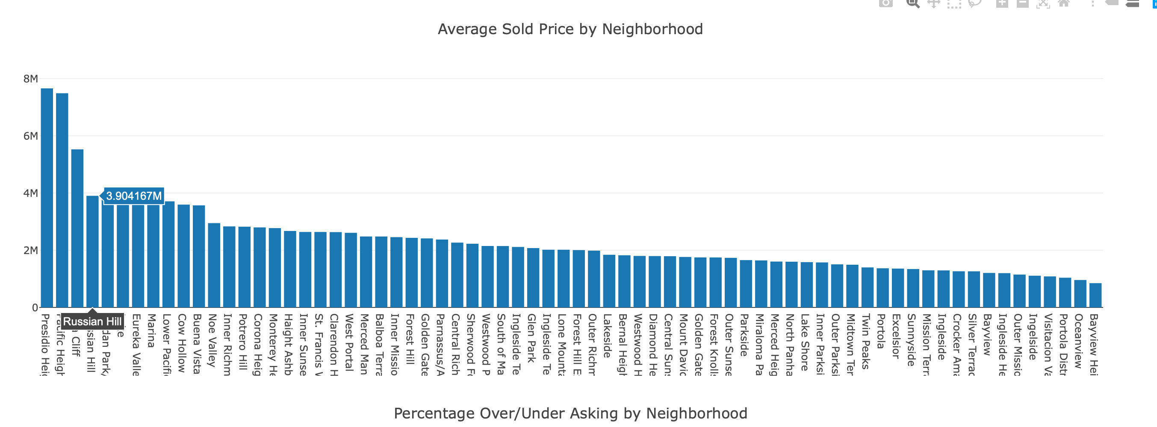
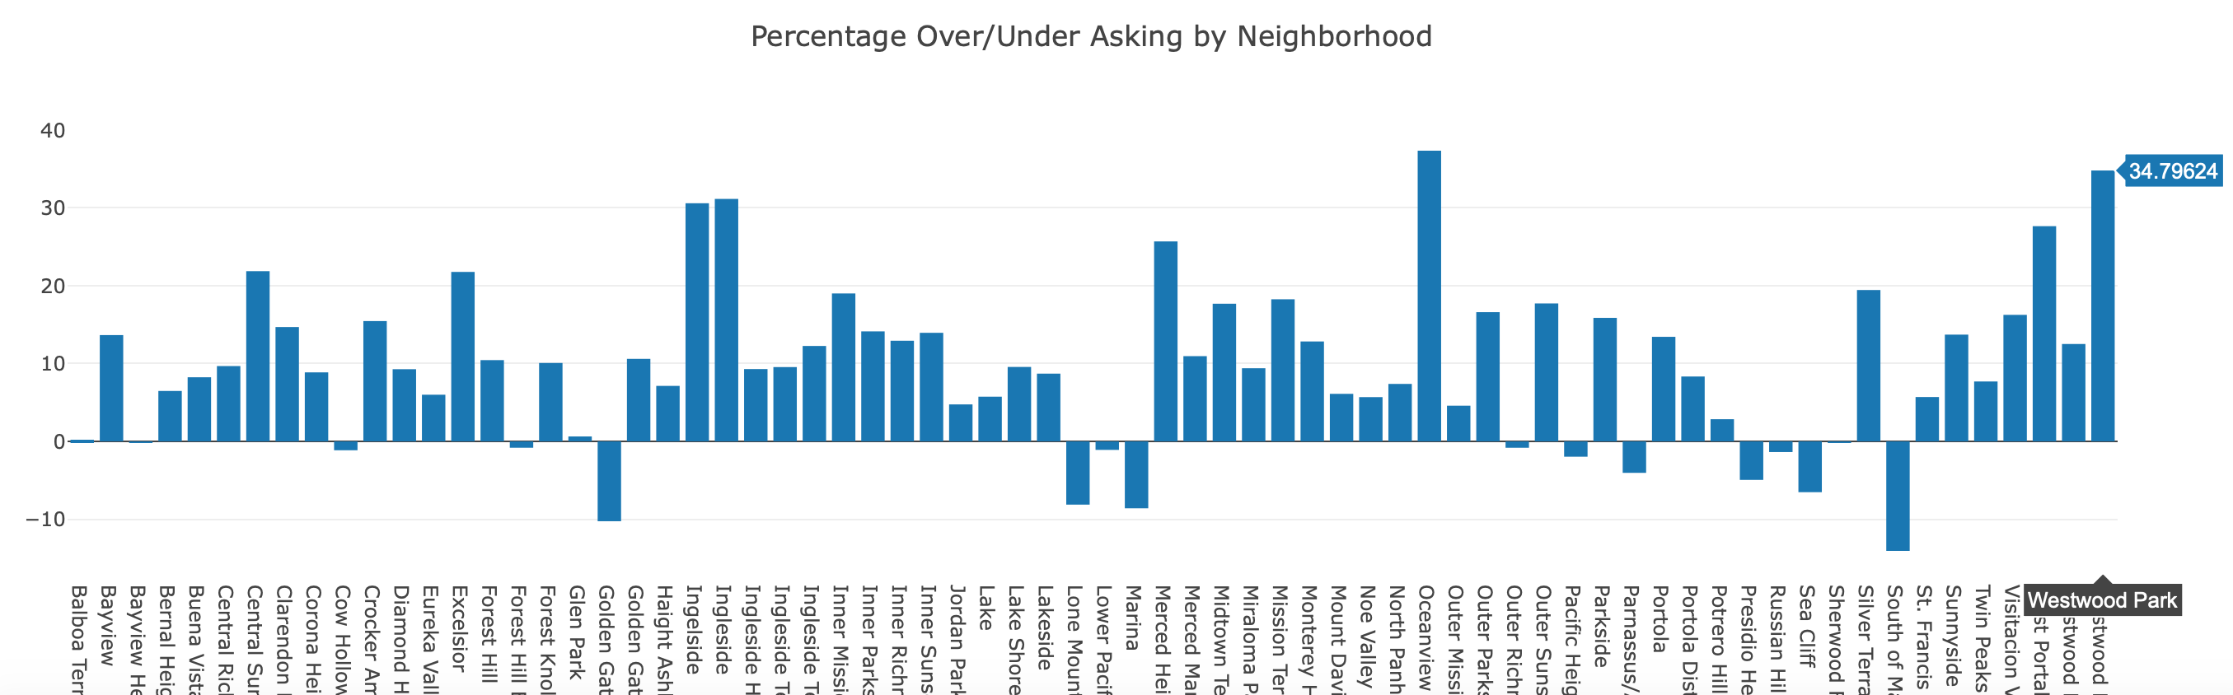
Review
Project 2:
Scraped Redfin and populated data in Google Maps
Notes:
If you remember I populated data in Google Maps with the parameters as 3 bedroom/2 bathrooms – SFH
I also created two charts with percentages over/ under asking price and average sold price by each neighborhood.
**INSERT PICTURES OF CHARTS**

Slide 3
Project 3: Creating the Estimate
Could I determine, based on previous and current data, the price that the house would go for?

Slide 4




Libraries Used
Scikit-Learn
D3 for charts
Google Maps SDK
SQLite Database
Beautiful Soup
Splinter

Slide 5

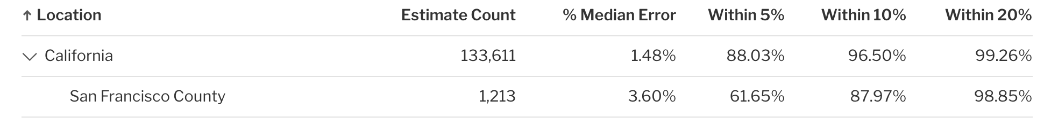
Data
1. Scraped more sold listing and added active listings
Notes:
1. Once again I used my past data and added a few more points to be able to create Linear Regression model
2. Before we added the original price was bedroom, bathroom, and sq ft. As we added more features our accuracy grew and listing price put us over the top.
3. I should also note that Redfin is the most accurate housing estimate in the current market by SSRS standards.
SSRS () – is a marketing research firm

Slide 6

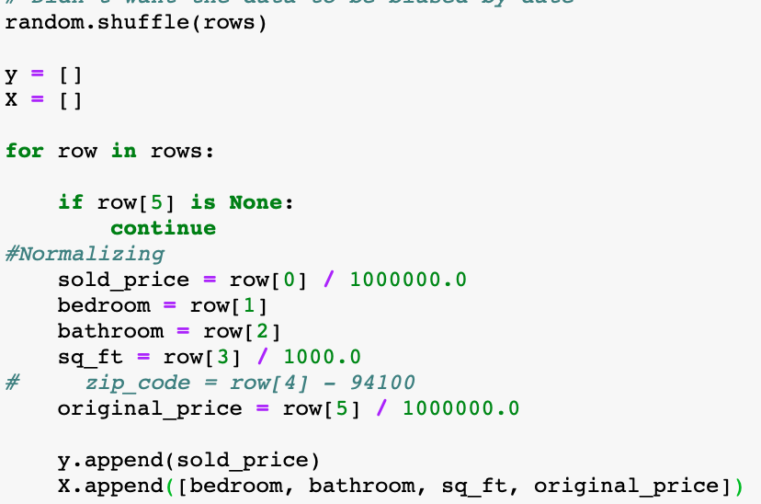
Linear Regression Model
Notes:
First I shuffled the data from the datasets.
Y is my answer (sold price)
X is all of my features
Set it to random because I didn’t want the data to be biased by date.
Scaled the data for it be similar magnitudes. I didn’t do anything to bedrooms and bathrooms. Sold Price and Listing Price I divided by a million and sq ft. I divided by 1000.

Slide 7

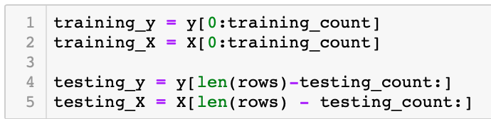
Linear Regression Model
Notes:
Split it into training and testing mode 70/30

Slide 8
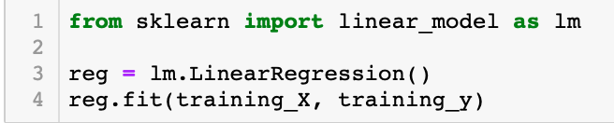
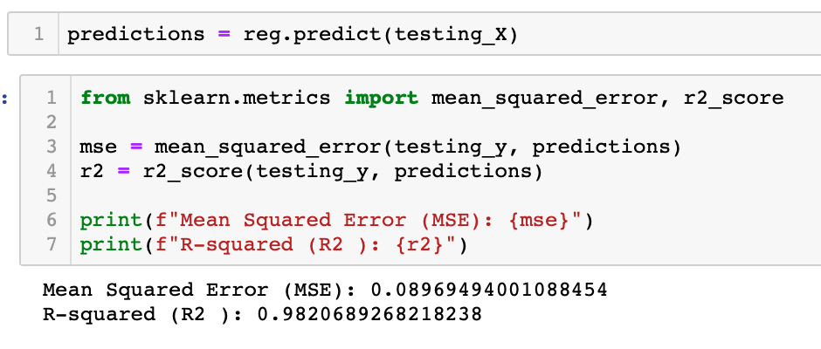
Linear Regression Model
Notes:
1.Trained it and tested it and found my R-Squared as .98

Slide 9
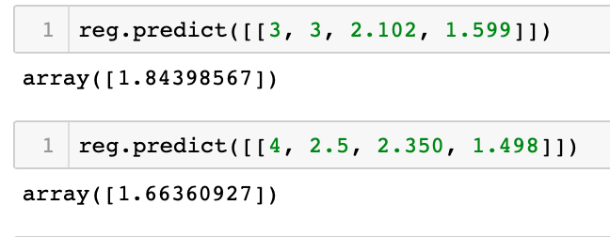
Linear Regression Model
Notes:
Played with my “Vanesstimate”
Bedroom
Bathroom
Sq Ft.
Listing Price

Slide 10
Accuracy
Bedroom
Bathroom
Sq ft.
4. Added Listing Price
5. Tried Zip Code
Notes:
After I ran my first test I was about a R- Squared Score .42. I was able to scrape and then add the listing price and it jumped up to a R- Squared Score of .94 accuracy again our own data.
We trained it on our original data set first. Then we added current active listings and updated additional sold listings which increased to .98.
2. Before we added the original price was bedroom, bathroom, and sq ft. As we added more features our accuracy grew and listing price put us over the top.
3. I did train the model with zipcode sbut decided against it because it was too complex and we already had a pretty high rating. In the future I could add it to increase the score. Might be that we don’t need listing price and zip code could replace that heavy feature.

Slide 11
Model limitations
R- Squared Score .98 accuracy against own data
Model is not used for a consumer wanting to list their house.
Good for the consumer who wants to know what a house will go for.
Sold price is also based on an emotion
Model is behind the market change
Notes:
Even though I received a .98 of accuracy it’s only against my own data and not live data.
Our model is terrible for a seller trying to list their house. I can’t use the listing price as the listing price is one of the heavy features. Usually in another county you would normally list your house the price you want to sell your house. For the case of SF prices are always listed at the bottom or at the very least they would take. (Often not even accepting that price at all).
I should also note that a sold price is also based on an emotion and that our model can’t be 100% accurate due to the human behavior of sold prices (no human or ML is 100% accurate anyway)
My model also has no knowledge of the market taking a down turn and has no concept of time or seasonality into account.
**Reason it’s priced so low is to gain interest.

Slide 12
Life Advice
“Don’t pickle something you don’t know”
Notes:
Used pickle to save the model to disk.
--Pickleing allows you to save a python object as a binary file on your hard drive. After you pickle your object, you can kill your python session.
Don’t pickle unknowns as it has malicious codes

Slide 13
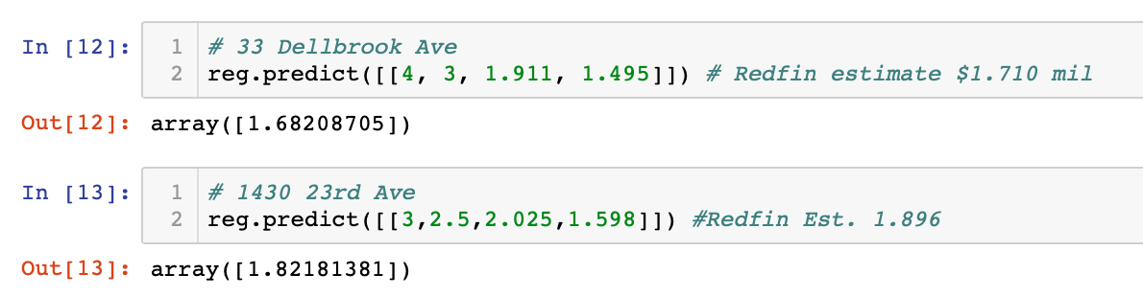
Can I estimate sold price listings?
Kinda – but you’d be over paying.
-Pulled April 2019
Notes:
April is normally the highest sold price month so for me to pull the data it created my model to constantly be far over asking price. Currently in this particular summer (as its not always the case) SF is taking a down turn resulting in my model more than it should be.
** Show Google Maps with estimate play.

Slide 14
What I learned:
Notes:
*Google Filtering
*Took Project 2 and added this capabilities
*Everything was designed about listings that been sold and now we changed it to both sold and active listings
- Modified scraping to handle sold and active listings because there’s different data available.
*Change database schema I had to change it if the “sold pricing” was 0 it had to be a “Active Listing”

